Slide 1
Sorting and Searching – Divide and Conquer Approach

Slide 2
Instructor
Dr. Ab Rouf Khan
Assistant Professor
VIT Bhopal University

Slide 3
Outline [Module 2 (Part 2)]
Divide and Conquer (DAC) Approach: General Method.
Sorting
Merge Sort
Quick Sort
Searching
Binary Search

Slide 4
Divide and Conquer (DAC) approach
An effective approach to designing fast algorithms in sequential computation.
Strategy:
Divide | Divide
Conquer | Recur
Combine | Conquer
7 2 ⏐ 9 4 → 2 4 7 9
7 ⏐ 2 → 2 7
9 ⏐ 4 → 4 9
7 → 7
2 → 2
9 → 9
4 → 4

Slide 5
Divide and Conquer (Recap)
Divide the problem into a number of sub-problems
Similar sub-problems of smaller size
Conquer the sub-problems
Solve the sub-problems recursively
Sub-problem size small enough ⇒ solve the problems in straightforward manner
Combine the solutions of the sub-problems
Obtain the solution for the original problem

Slide 6
Sorting (Recap)
Insertion sort
Design approach:
Sorts in place:
Best case:
Worst case:
Bubble Sort
Design approach:
Sorts in place:
Running time:
incremental
Yes
Θ(n)
Θ(n²)
incremental
Yes
Θ(n²)

Slide 7
Sorting (Recap)
Selection sort
Design approach:
Sorts in place:
Running time:
Merge Sort
Design approach:
Sorts in place:
Running time:
incremental
Yes
Θ(n²)
divide and conquer
No
Let’s see!!

Slide 8
Merge Sort
Key Idea: To sort an array A[p . . r]:
Divide
Divide the n-element sequence to be sorted into two subsequences of n/2 elements each
Conquer
Sort the subsequences recursively using merge sort
When the size of the sequences is 1 there is nothing more to do
Combine
Merge the two sorted subsequences

Slide 9
Merge Sort – Pseudocode
p
q
r
Alg.: MERGE-SORT(A, p, r)
if p < r Check for base case
then q ← ⎣(p + r)/2⎦ Divide
MERGE-SORT(A, p, q) Conquer
MERGE-SORT(A, q + 1, r) Conquer
MERGE(A, p, q, r) Combine
Initial call: MERGE-SORT(A, 1, n)
1
2
3
4
5
6
7
8
5
2
4
7
1
3
2
6

Slide 10
Merge Sort – Example – n power of 2
Divide
1
2
3
4
5
6
7
8
q = 4
5
2
4
7
1
3
2
6
1
2
3
4
5
6
7
8
5
2
4
7
1
3
2
6
1
2
3
4
5
6
7
8
5
2
4
7
1
3
2
6
1
2
3
4
5
6
7
8
5
2
4
7
1
3
2
6

Slide 11
Merge Sort – Example – n power of 2
Conquer
and
Merge
1
2
3
4
5
6
7
8
1
2
2
3
4
5
6
7
1
2
3
4
5
6
7
8
2
4
5
7
1
2
3
6
1
2
3
4
5
6
7
8
2
5
4
7
1
3
2
6
1
2
3
4
5
6
7
8
5
2
4
7
1
3
2
6

Slide 12
Merge Sort – Example – n NOT a power of 2
1
2
3
4
5
6
7
8
9
10
11
q = 6
Divide
4
7
2
6
1
4
7
3
5
2
6
q = 3
1
2
3
4
5
6
7
8
9
10
11
q = 9
4
7
2
6
1
4
7
3
5
2
6
1
2
3
4
5
6
7
8
9
10
11
4
7
2
6
1
4
7
3
5
2
6
1
2
3
4
5
6
7
8
9
10
11
4
7
2
6
1
4
7
3
5
2
6
1
2
4
5
7
8
4
7
6
1
7
3

Slide 13
Merge Sort – Example – n NOT a power of 2
Conquer
and
Merge
1
2
3
4
5
6
7
8
9
10
11
1
2
2
3
4
4
5
6
6
7
7
1
2
3
4
5
6
7
8
9
10
11
1
2
4
4
6
7
2
3
5
6
7
1
2
3
4
5
6
7
8
9
10
11
2
4
7
1
4
6
3
5
7
2
6
1
2
3
4
5
6
7
8
9
10
11
4
7
2
1
6
4
3
7
5
2
6
1
2
4
5
7
8
4
7
6
1
7
3

Slide 14
Merging two sorted subarrays
p
q
r
1
2
3
4
5
6
7
8
2
4
5
7
1
2
3
6
Input: Array A and indices p, q, r such that p ≤ q < r
Subarrays A[p . . q] and A[q + 1 . . r] are sorted
Output: One single sorted subarray A[p . . r]

Slide 15
Merging
Idea for merging:
Two piles of sorted cards
Choose the smaller of the two top cards
Remove it and place it in the output pile
Repeat the process until one pile is empty
Take the remaining input pile and place it face-down onto the output pile
p
q
r
1
2
3
4
5
6
7
8
2
4
5
7
1
2
3
6
A1← A[p, q]
A[p, r]
A2← A[q+1, r]

Slide 16
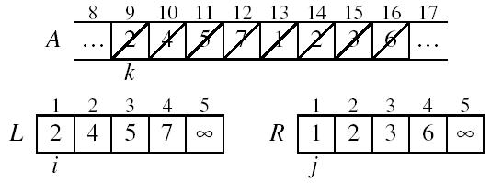
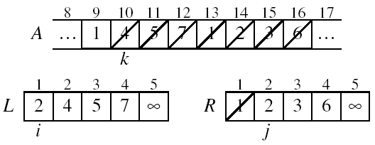
Example: MERGE(A, 9, 12, 16)
p
q
r

Slide 17
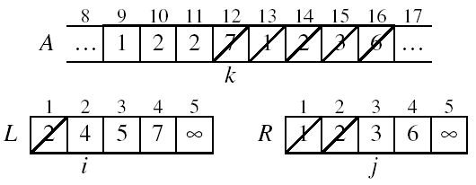
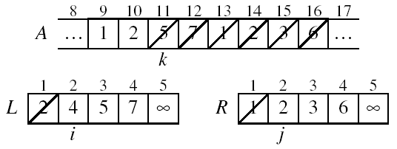
Example: MERGE(A, 9, 12, 16)

Slide 18
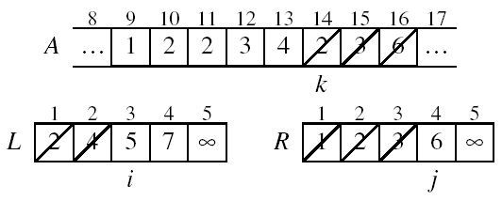
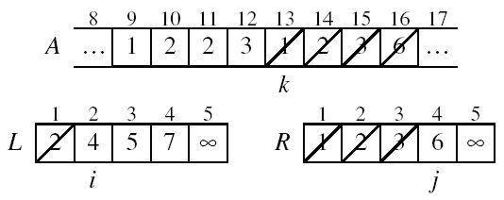
Example: MERGE(A, 9, 12, 16)

Slide 19
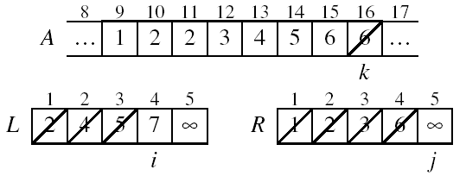
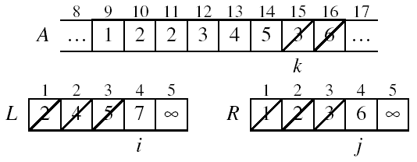
Example: MERGE(A, 9, 12, 16)

Slide 20
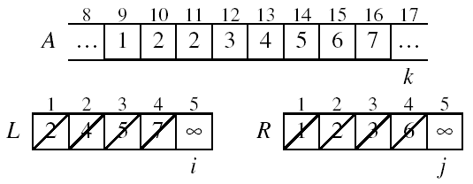
Example: MERGE(A, 9, 12, 16)
Done!

Slide 21
MERGE – Pseudocode
p
r
Alg.: MERGE(A, p, q, r)
Compute n₁ and n₂
Copy the first n₁ elements into
L[1 . . n₁ + 1] and the next n₂ elements into R[1 . . n₂ + 1]
L[n₁ + 1] ← ∞; R[n₂ + 1] ← ∞
i ← 1; j ← 1
for k ← p to r
do if L[ i ] ≤ R[ j ]
then A[k] ← L[ i ]
i ←i + 1
else A[k] ← R[ j ]
j ← j + 1
q
1
2
3
4
5
6
7
8
2
4
5
7
1
2
3
6
n₁
n₂
p
q
L
2
4
5
7
∞
q + 1
r
R
1
2
3
6
∞

Slide 22
Running Time of Merge (assume last for loop)
Initialization (copying into temporary arrays):
Θ(n₁ + n₂) = Θ(n)
Adding the elements to the final array:
- n iterations, each taking constant time ⇒ Θ(n)
Total time for Merge:
Θ(n)

Slide 23
Analyzing Divide and Conquer Algorithms
The recurrence is based on the three steps of the paradigm:
T(n) – running time on a problem of size n
Divide the problem into a subproblems, each of size n/b: takes D(n)
Conquer (solve) the subproblems aT(n/b)
Combine the solutions C(n)
Θ(1) if n ≤ c
T(n) = aT(n/b) + D(n) + C(n) otherwise

Slide 24
Merge Sort – Running Time
Divide:
compute q as the average of p and r: D(n) = Θ(1)
Conquer:
recursively solve 2 subproblems, each of size n/2 ⇒ 2T (n/2)
Combine:
MERGE on an n-element subarray takes Θ(n) time ⇒ C(n) = Θ(n)
Θ(1) if n =1
T(n) = 2T(n/2) + Θ(n) if n > 1

Slide 25
Solve the Recurrence!
T(n) = c if n = 1
2T(n/2) + cn if n > 1
Use Master’s Theorem:
Compare n with f(n) = cn
Case 2: T(n) = Θ(nlgn)

Slide 26
Merge Sort - Discussion
Running time insensitive of the input
Advantages:
Guaranteed to run in Θ(nlgn)
Disadvantage
Requires extra space ≈N

Slide 27
Sorting Challenge – 1
Problem: Sort a file of huge records with tiny keys
Example application: Reorganize your MP-3 files
Which method to use?
merge sort, guaranteed to run in time ∼NlgN
selection sort
bubble sort
a custom algorithm for huge records/tiny keys
insertion sort

Slide 28
Sorting Challenge – 2
Problem: Sort a huge randomly-ordered file of small records
Application: Process transaction record for a phone company
Which sorting method to use?
Bubble sort
Selection sort
Mergesort guaranteed to run in time ∼NlgN
Insertion sort

Slide 29
Sorting Challenge – 3
Problem: sort a file that is already almost in order
Applications:
Re-sort a huge database after a few changes
Double-check that someone else sorted a file
Which sorting method to use?
Merge sort, guaranteed to run in time ∼NlgN
Selection sort
Bubble sort
A custom algorithm for almost in-order files
Insertion sort

Slide 30

Recap

Slide 31
Thank You

